Slide 1
Relationship exploration between Birds, Demographic and Economic metrics.
Capstone 1 : Experimental design

Slide 2
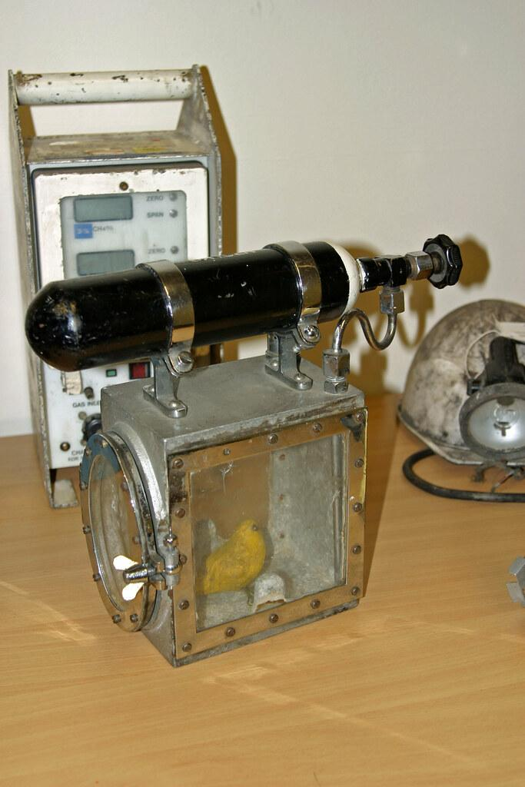
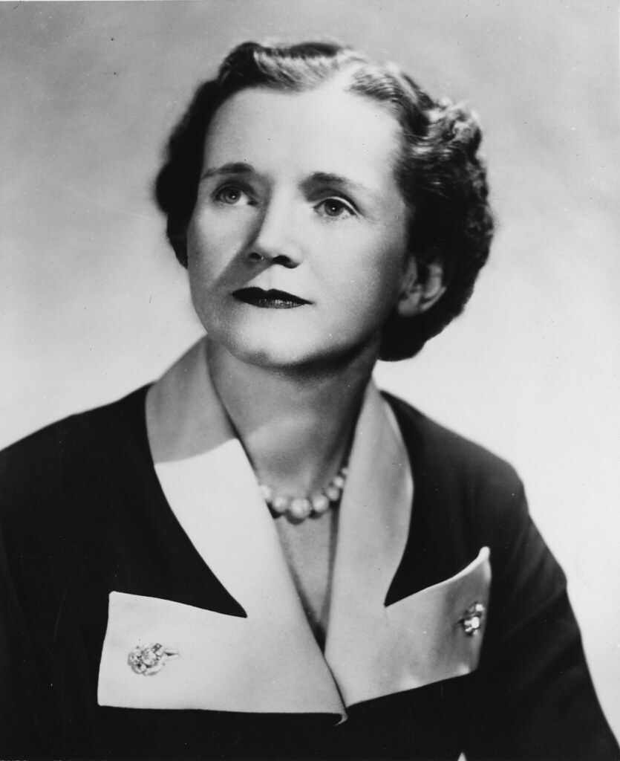

Introduction: Birds as Environmental Indicators
Notes:
Introduction:
Coal mining canary and Rachel Carson book are examples of birds as environmental indicators.
Canaries helped keep miners safe by detecting carbon monoxide.
Rachel Carson book Silent Spring and the case of the DDT the Bald Eagle and the Brown Pelican.
Purpose of the study:
The citizen scientist concept is helping collect robust data on projects like eBird. The eBird Database have been effective on collecting data that describe the birds distributions on a global scale.
In this case we will use the eBird data to explore relationships between sets that could lead to the development of a model that would detect an instance of environmental degradation.
Traditionally pollution is cause by the externalities of the economic activities, we will use the GDP to explore any possible relationship with the birds distributions.
Also, we will use census data to explore any possible relationship between humans population and bird distributions.

Slide 3
Notes
Introduction:
Coal mining canary and Rachel Carson book are examples of birds as environmental indicators.
Canaries helped keep miners safe by detecting carbon monoxide.
Rachel Carson book Silent Spring and the case of the DDT the Bald Eagle and the Brown Pelican.
Purpose of the study:
The citizen scientist concept is helping collect robust data on projects like eBird. The eBird Database have been effective on collecting data that describe the birds distributions on a global scale.
In this case we will use the eBird data to explore relationships between sets that could lead to the development of a model that would detect an instance of environmental degradation.
Traditionally pollution is cause by the externalities of the economic activities, we will use the GDP to explore any possible relationship with the birds distributions.
Also, we will use census data to explore any possible relationship between humans population and bird distributions.

Slide 4
Who could benefit from this study?
Regulators by assisting on gap analysis to enforce or legislate environmental rules.
Protecting general public health of the most sensitive individuals.

Slide 5
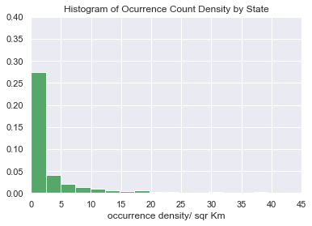
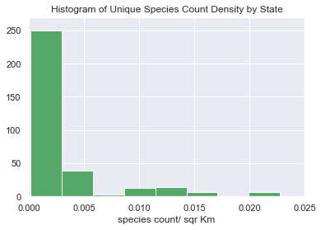
Data Sources
eBird:collective enterprise that takes a novel approach to citizen science.
Temporal scope
3/5/1810 - 12/31/2019

Slide 6
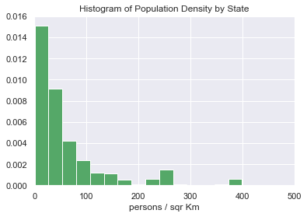
Data Sources
United State Census Bureau
National Intercensal Datasets
2019 TIGER/Line Shapefiles.

Slide 7
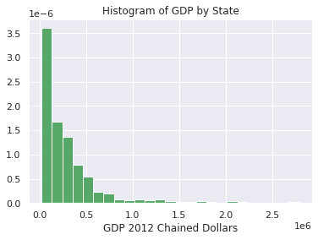
Data Sources
The U.S. Bureau of Economic Analysis
Real Gross Domestic Product (GDP) by state.
Chained-dollars based on 2012 period.

Slide 8
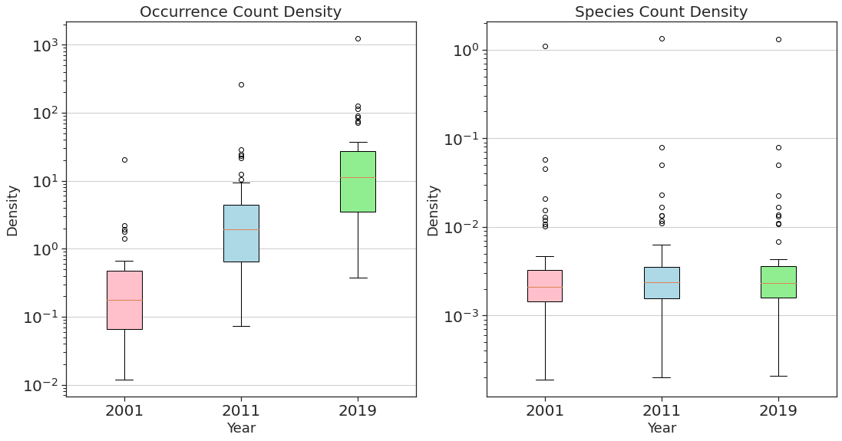
Kruskal-Wallis test
Statistics=89.441, p=0.000
Different distributions ( reject H0)
Statistics=1.055, p=0.590
Same distributions (fail to reject H0)
Notes:
Significant difference in occurrence density between the years 2001, 2011 and 2019.
No significant difference in GDP, Population Density or Unique Species Count Density between the years 2001, 2011 and 2019.

Slide 9
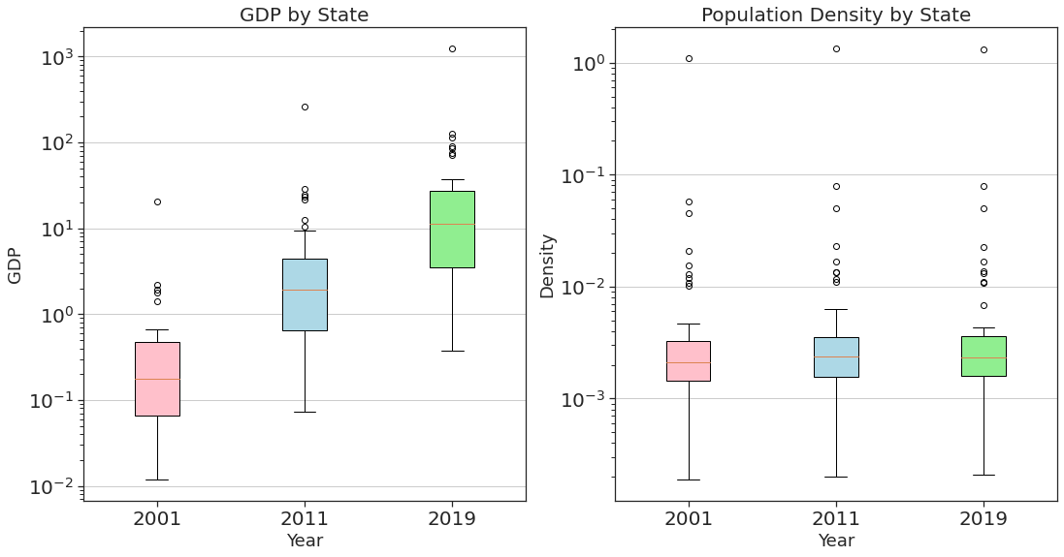
Kruskal-Wallis test
Statistics=2.196, p=0.334
Same distributions (fail to reject H0)
Statistics=0.699, p=0.705
Same distributions (fail to reject H0)

Slide 10
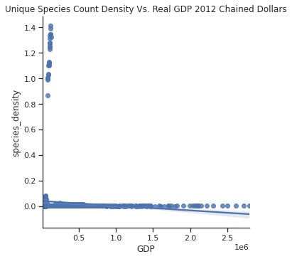
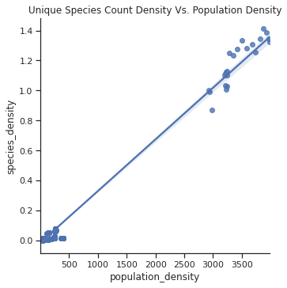
Spearman COrrelation Test
Spearman r=0.041977, p=0.150781
(fail to reject H0)
Spearman r=0.714799, p=4.320186e-184
(reject H0)

Slide 11
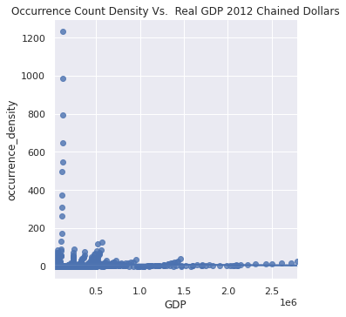
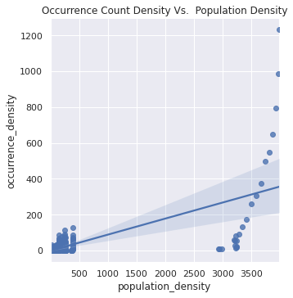
Spearman COrrelation Test
Spearman r=0.397223, p=1.262781e-45
(reject H0)
Spearman r=0.622517, p=8.166804e-127
(reject H0)

Slide 12
DAta Interpretation
Significant difference in occurrence density between the years 2001, 2011 and 2019.
No significant difference in GDP, Population Density or Unique Species Count Density between the years 2001, 2011 and 2019.
No correlations between Unique Species Density and GDP.
Strong positive correlation between Unique Species Density and Population Density.
Moderate positive correlations between Occurrence Density with GDP and Population Density.

Slide 13
CONCLUSION
More testing is required to identify a relationship that would allow using the eBird database as a environmental indicator. Some recommendations are:
Focus on specific species, maybe the most sensitive ones.
Using Current Value GDP (instead of Real GDP) and correct for inflation in the study to have a larger dataset. Real GDP dataset begins in 1997.
Breaking down the GDP data by industry group.
Including pollution discharges data from EPA permits.

Slide 14
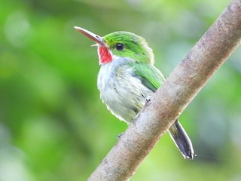
Questions?

Slide 15
Distribution Histograms
nobs | 1173
min | 0.0002
max | 1.14
mean | 0.029
variance | 0.027
skewness | 7.04
kurtosis | 48.56

Slide 16
Distribution Histograms
nobs | 1173
min | 0.0024
max | 1231.55
mean | 10.30
variance | 3872.82
skewness | 13.71
kurtosis | 216.16

Slide 17

Distribution Histograms
nobs | 1173
min | 20026.1
max | 2792029.1
mean | 300538.81
variance | 139596406094.73
skewness | 3.10
kurtosis | 11.88

Slide 18
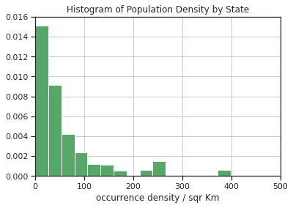
Distribution Histograms
nobs | 1173
min | 0.353
max | 3986.66
mean | 127.91
variance | 225514.30
skewness | 6.76
kurtosis | 48.56

